Slide 1
Edit new watch requirements ( PartB )
Create new watch requirements ( PartB )
Button to create new watch
New watch created by default with local time
Select time zone to be applied on new watch
Add watch button to toggle between 12 to 24 hours format
Reset button to reset overridden hours and minutes not time zone
Select time zone to be applied on new watch
Delete button per watch
Draggable watch

Slide 2
Model class diagram ( PartB )
Scene
-watches[]:array
-watchesIndex:int
-deltaGMT:int
+addWatch(watchesIndex,
deltaGMT)
+removeWatch(watchesIndex)
1
MODEL
contains
n
TwoDigitalNumber
DigitalNumber
WatchModel
- First:DigitalNumber
- Second:DigitalNumber
- Group:ThreeGroup
- Number:int
-Hours:TwoDigitalNumber
-Minutes:TwoDigitalNumber
-Seconds:TwoDigitalNumber
-deltaHours:int
-deltaMinutes:int
-ampmButtonState:int
-deltaGMT:int
1
2
1
3
contains
#Create
+setNumber( number:int )
+getNumber():int
+updateNumber( number:int)
#Init()
+Update( number:int )
contains
+Update()
#initNumbers()
#initDots()
#initWatchButtons()
#initWatchFace()
+setWatchFaceColor( color:color )
+increaseHours()
+increaseMinutes()
WatchButton
-name:string
-positionX:float
-position:float
-positionZ:float
1
n
contains
#init( name, positionX, position, positionZ )

Slide 3
State machine diagram ( PartB )
set deltaGMT gui
Move watch in scene
Drag & Drop
Initial scene
press AddWatch gui
Add watch in scene
With deltaGMT
press Delete button
Remove selected watch from scene
12h watch format
press AM/PM button
24h watch format
Reset overridden hours and minutes
press Reset button
press AM/PM button

Slide 4
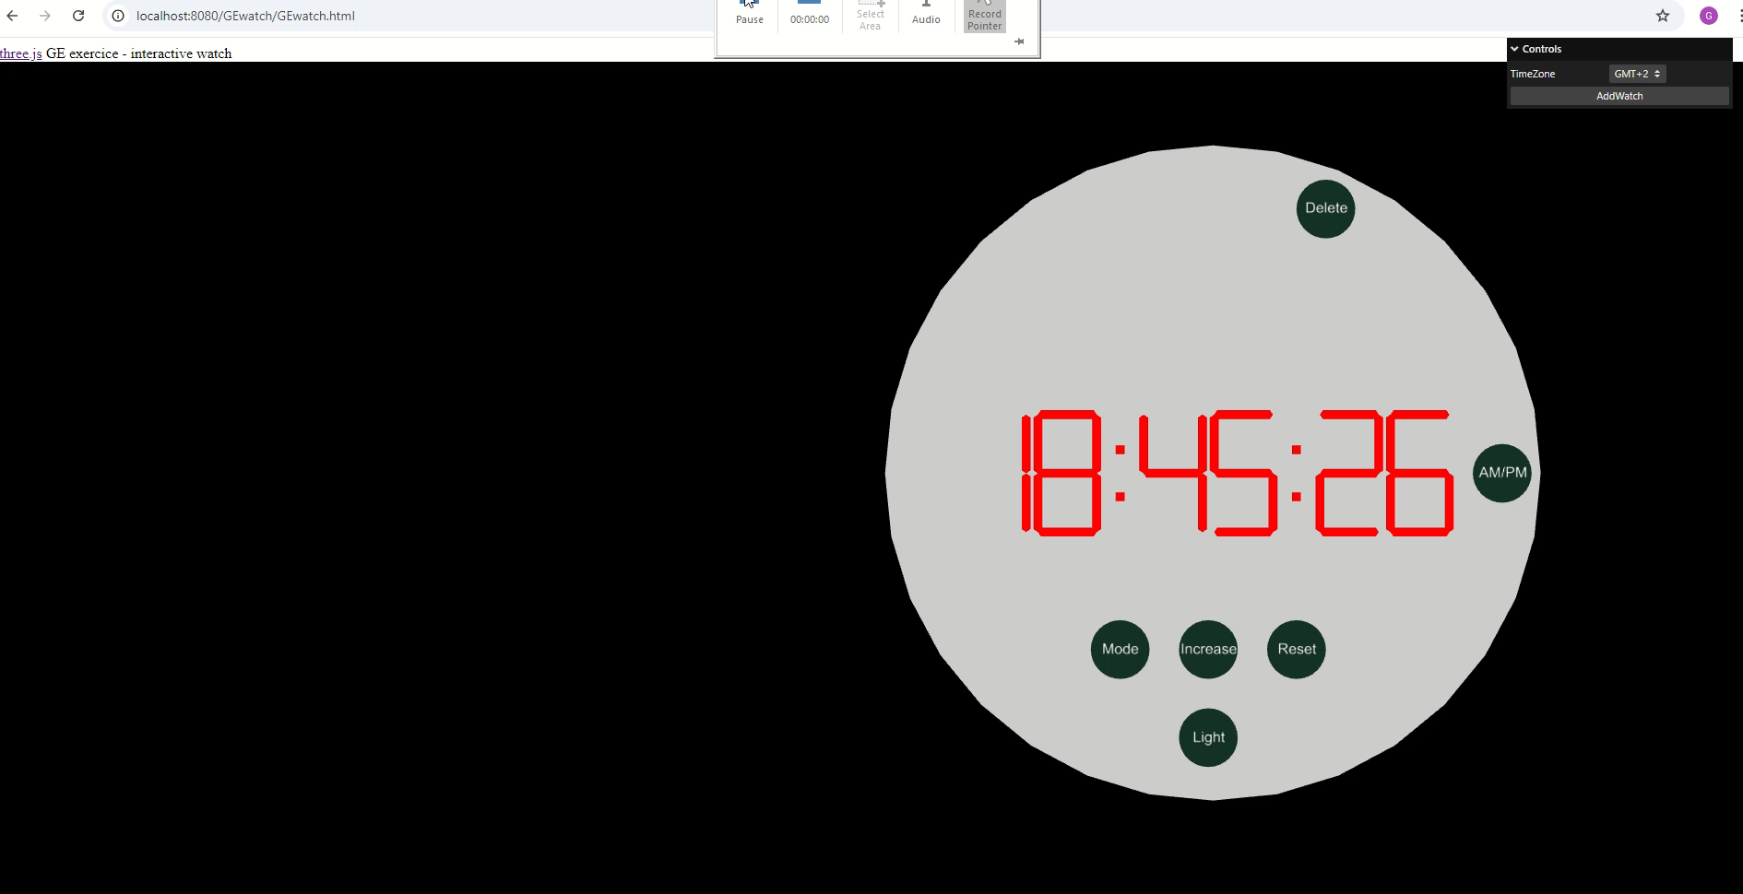
Watch render and user interactions ( PartB )

